Slide 1
World Population - EDA
By:- Rohith Narayanan S
Tel: +91 9444552572
Email: narayanansrohith@gmail.com
LinkedIn: linkedin.com/in/rohith-narayanan-61630318b
GitHub: RohithNarayananS (Rohith Narayanan S) (github.com)

Slide 2
Approach
Visualization of Dataset
Data Encoding
Visualization after Data Encoding

Slide 3
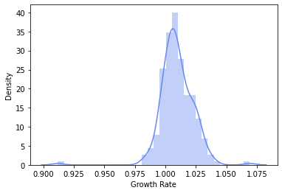
1. Growth Rate has a unique form of distribution with highest value in between 1 & 1.025

Slide 4
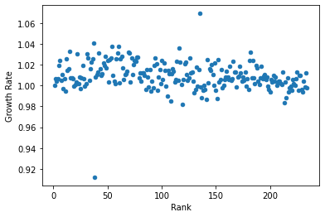
2. Growth Rate & Rank has a unique form of distribution

Slide 5
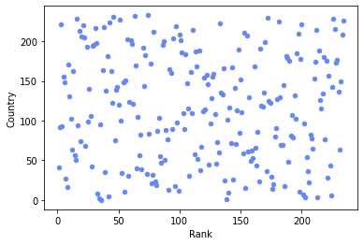
3. We can see a wide distribution between Country & Rank

Slide 6
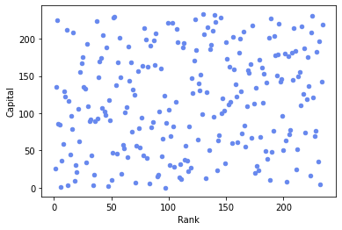
4. We can see a wide distribution between Capital & Rank

Slide 7
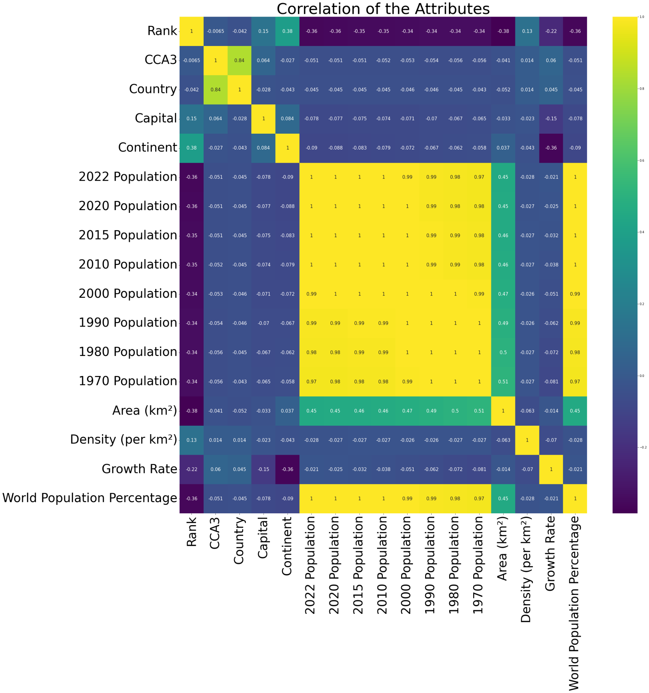
5. The data correlation of many attributes are high in nature resulting in a highly correlated dataset

Slide 8
EDA Completed Successfully
max growth
Thank you for the Opportunity

